Slide 1

Vertical Pile Load Test using Reaction Anchors
Client – APCO Infratech Pvt Ltd.

Slide 2

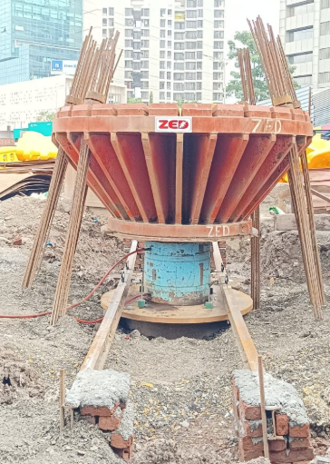
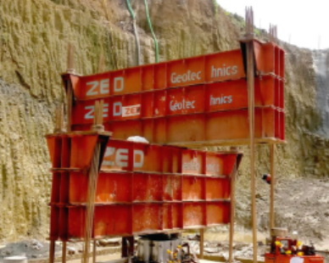
Why Vertical Pile Load Test Important?
Vertical Pile Load Test is a critical verification step for deep foundations. - Confirmation of design assumptions (bearing capacity and settlement).
Risk mitigation and ensuring regulatory compliance.

Slide 3
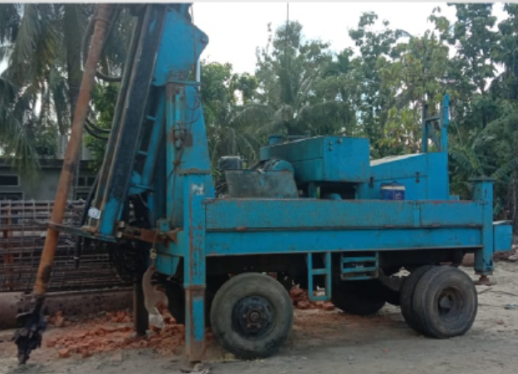
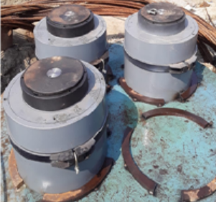
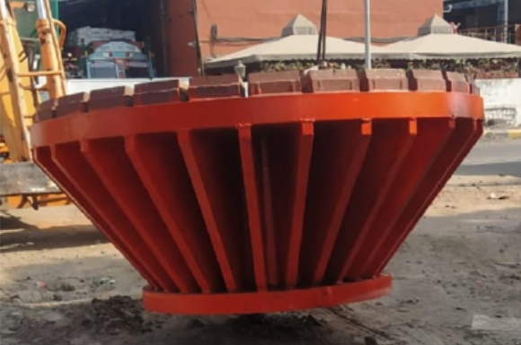
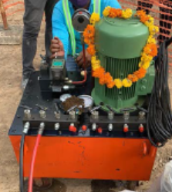
Equipment required to conduct VPLT
DTH/Rotary drilling rigs - For drilling holes of suitable diameter.
Hydraulic Jack/s – As per test load.
Testing Frame
Hydraulic PowerPack

Slide 4
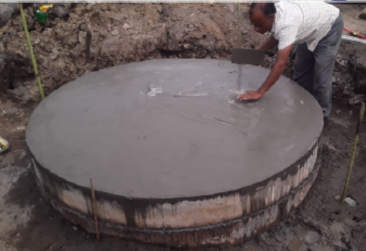
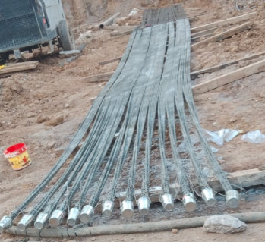
Preparation & Initial Setup
Goal: Establish the test site and confirm readiness as per IS 2911 (Part 4).
Pile Head Preparation:
  Chip the test pile head down to sound concrete and trim to a smooth, horizontal plane, normal to the pile axis.
  Place a steel bearing plate centrally on the pile head for the hydraulic jack to rest.
Reaction Anchor Installation (The Reaction System):
  Drill anchor boreholes into competent strata at the code-specified distance.
  Install the assembled HT strand tendons.
  Grout the Fixed Length and ensure full curing.
Frame Assembly:
  Erect the reaction crown/girder system over the hydraulic jack/s placed on pile head, connecting it securely to the anchor heads.

Slide 5
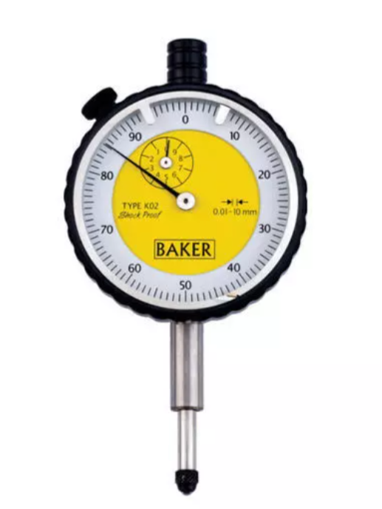
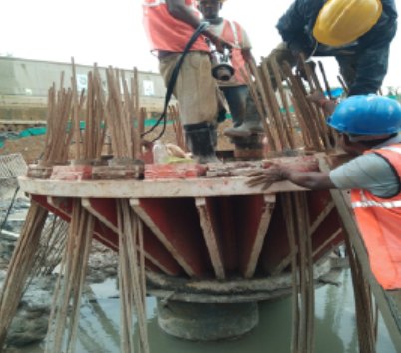
Instrumentation & Anchor Loading
Goal: Detail the precise measurement system and the critical pre-loading of the anchor system.
Instrumentation Setup:
  Position a tested hydraulic jack directly under the reaction frame, centered on the test pile bearing plate.
  Set up a minimum of four dial gauges of 0.01mm sensitivity, equally spaced around the pile head.
  Mount the dial gauges on datum bars supported on immovable reference points placed at a safe distance.
Reaction Anchor Pre-Loading (Loading the Reaction Crown):
  Use a stressing jack to tension the anchor strands individually against the anchor bearing plates.
  Tension is applied to remove the slack from HT strands.
  The required reaction load is locked-off by securing the wedges and lock-off nuts onto the anchor bearing plates.
Final Checks:
  Verify all instruments are at zero and certificates (for calibration, concrete strength) are current.

Slide 6
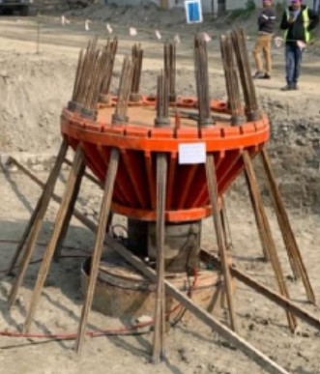
The Loading Procedure & Reporting
Goal: Summarize the execution of the test, following the Maintained Load Method (IS 2911), and the final output.
Loading Execution (Maintained Load Method):
  Apply the test load incrementally 20% of the Safe Working Load.
  At each increment, record load and displacement readings.
Maximum Load Application:
  For Initial Tests, loading continues up to 2.5 times of safe load and Routine Test
  is 1.5 times of safe load or until failure criteria are met.
  The final maximum load is maintained for $24$ hours.
Unloading & Recovery:
  Remove the load in decrements, measuring the recovery (rebound) at each stage.
  Record the final Net Settlement after all load is removed.
Analysis & Report:
  Plot the Load vs. Settlement curves.
  Determine the Ultimate Load Capacity and the Safe Load based on the prescribed IS 2911 criteria.

